Slide 1

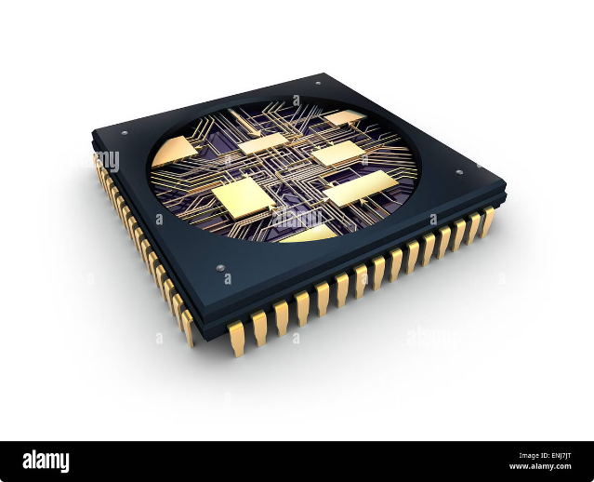
Introduction to Memory Paging
Memory paging is a memory management technique that divides a computer's main memory into fixed-size units called pages. This technique allows the operating system to efficiently allocate memory to processes, preventing them from interfering with each other and improving overall system performance.
KS

Slide 2

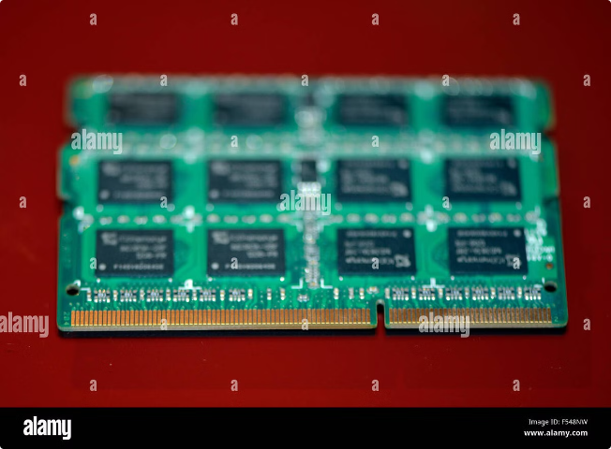
What is Memory Paging?
Memory paging is a technique that breaks down a process's memory into smaller units called pages. These pages are then stored in physical memory frames. This approach allows for flexible allocation of memory to different processes, improving efficiency and reducing memory fragmentation.
Page
A unit of memory in the virtual address space of a process.
Frame
A unit of memory in the physical address space of the system.
Page Table
A data structure used by the operating system to translate virtual addresses to physical addresses.

Slide 3

Importance of Visualization in Memory Paging
Visualizing memory paging is crucial for understanding how it works and for identifying potential performance bottlenecks. It helps developers and system administrators visualize the memory allocation process, analyze memory access patterns, and optimize system performance.
1
Understanding
2
Debugging
3
Optimization
Visualizations provide an intuitive way to grasp complex memory management concepts.
Visualizations assist in pinpointing memory leaks and other memory-related issues.
Visualizations aid in optimizing memory usage by highlighting inefficient memory allocation patterns.

Slide 4
Key Components of a Memory Paging Visualization Tool
A memory paging visualization tool should include components that allow users to interact with and manipulate various aspects of memory paging, including page frames, page tables, and memory access patterns.
Page Frame Visualization
Page Table Visualization
Memory Access Visualization
Display physical memory frames with their current status: occupied or free.
Illustrate the mapping between virtual and physical addresses, including page table entries.
Show the flow of memory accesses, highlighting page faults and cache misses.

Slide 5
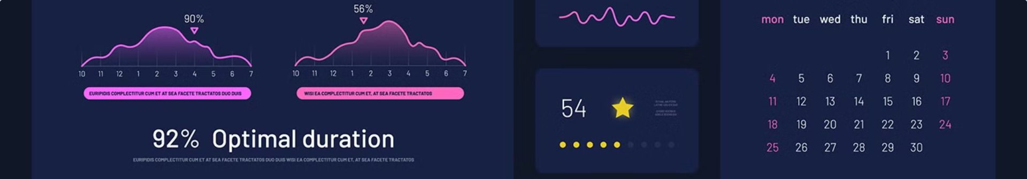




User Interface Design Considerations
The user interface of a memory paging visualization tool should be intuitive and easy to use, allowing users to quickly grasp the information and interact with the system effectively.
Configuration Options
Interactive Simulation
Performance Metrics
Zoom and Pan Capabilities
Display key performance metrics, such as page fault rate and memory access time.
Allow users to customize the visualization, such as choosing the size of pages and frames.
Enable users to simulate memory access scenarios and observe the behavior of the paging system.
Allow users to zoom in and out of different sections of the visualization for detailed examination.

Slide 6


Visualizing Page Frames and Page Tables
A memory paging visualization tool can effectively demonstrate the allocation of page frames in physical memory and the mapping between virtual and physical addresses in page tables.
Virtual Address
Physical Address
Page Frame
0x1000
0x2000
1
0x2000
0x4000
2
0x3000
0x6000
3

Slide 7


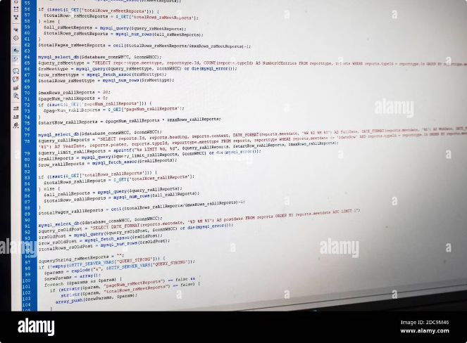



Simulating Page Replacement Algorithms
The tool can simulate various page replacement algorithms, such as FIFO (First In First Out), LRU (Least Recently Used), and Optimal, allowing users to observe their effects on performance.
Page Request
A process requests a page from memory.
Page Fault
The requested page is not in memory.
Page Replacement
The operating system selects a page to replace from memory.
Page Load
The requested page is loaded from secondary storage.

Slide 8
Analyzing Memory Access Patterns
Visualization tools can analyze the frequency and distribution of memory accesses, identifying common access patterns and potential memory bottlenecks.
1
Instruction Fetch
The CPU fetches instructions from memory.
2
Data Access
The CPU accesses data from memory for processing.
3
Cache Hit
The requested data is found in the cache.
4
Cache Miss
The requested data is not found in the cache.
5
Page Fault
The requested page is not in memory.

Slide 9
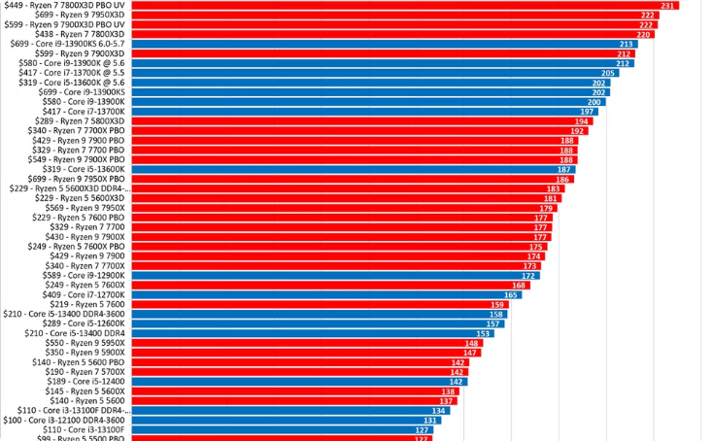
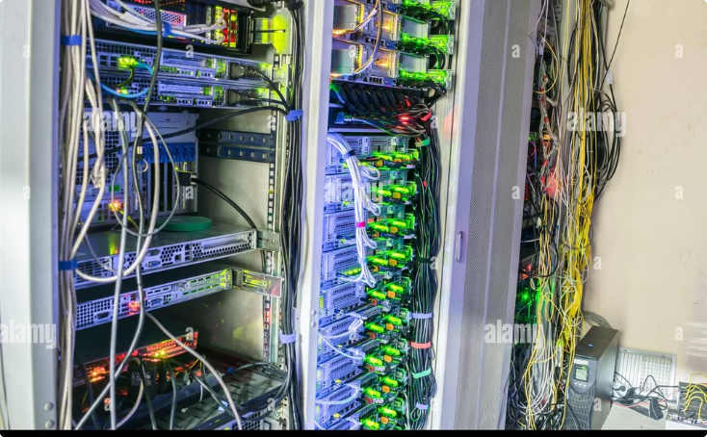
Identifying Memory Bottlenecks
By visualizing memory access patterns and analyzing performance metrics, users can pinpoint areas of contention and identify potential memory bottlenecks.
High Page Fault Rate
High Cache Miss Rate
Indicates inefficient memory allocation and excessive disk access.
Suggests poor cache utilization and inefficient data access patterns.

Slide 10


Real-Time applications
Real-time applications, such as video conferencing and online gaming, benefit greatly from efficient memory management techniques like memory paging.
1
Low Latency
Fast memory access is essential for real-time applications.
2
High Throughput
Memory paging can handle large volumes of data and requests.
3
Predictability
Consistent performance is crucial for real-time applications.

